Slide 1

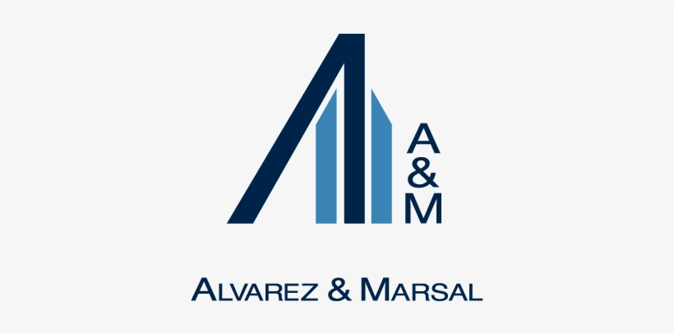
Alvarez & Marsal
An Analysis of IT, HR, and Organizational Dynamics

Slide 2

Organization Overview & Value Proposition
•
Global professional services firm (1983) specializing in restructuring & turnaround.
•
Known for execution-driven consulting and taking interim C-suite roles (CRO, CFO, COO).
•
Differentiators:
○
Strong restructuring heritage.
○
Conflict-free, independent advisory (no audit practice).
○
Integrated multidisciplinary capabilities (finance, ops, technology).
•
IT backbone supports real-time financial models, dashboards, and cross-geography collaboration.

Slide 3





HR Practices at A&M
TOP Solutions
Performance Mgmt
Tech-Enabled HR
Recruitment prioritizes experienced operators. Focus on individuals excelling under pressure. Development via mentorship, continuous feedback, and high accountability.
KPIs: revenue contribution, client feedback, speed, foresight. Utilization monitored via internal dashboards.
Advanced analytics for skill mapping, fair compensation, and team optimization. Predictive models for burnout & attrition risks.

Slide 4


Major IT & Organizational Challenges
Internal Challenges
External Challenges
Data Security: Handling confidential turnaround data increases cyber-risk exposure.
Rapid Digital Transformation: Clients expect quick modernization even during turbulence.
Knowledge Codification: Expertise concentrated with senior MDs; difficult to codify playbooks and methodologies.
M&A Complexity: Day-1 IT continuity, integration, and carve-outs require precision.
Operational Pressure: Need for fast execution while managing complex ecosystems.

Slide 5
IT Interventions to Overcome Challenges
Data Security: Zero-trust architecture, MFA, and continuous monitoring.
Knowledge Retention: Enterprise Knowledge Management System (KMS) for playbooks & archives.
Digital Transformation: Automation toolkits for IT due diligence & process streamlining.
M&A Complexity: Pre-configured frameworks enabling smooth Day-1 operations.
Core IT Enablers: Cloud standardization, automated workflows, real-time analytics, and alignment of IT with A&M’s execution-first consulting model.

Slide 6






Organizational Behavior at A&M
Execution Orientation
Operator Mindset
Objectivity & Transparency
Consultants operate as real-time change agents. IT mirrors this through agile cycles and rapid system deployment.
Preference for field-tested practitioners ensures high-impact decisions. IT investments evaluated on measurable client and operational efficiency.
No audit practice = unbiased recommendations. IT governance remains vendor-neutral & flexible.

Slide 7
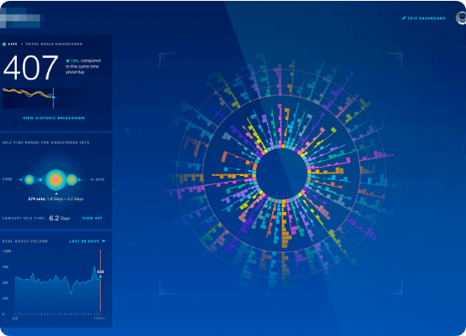
Case Study: IT Intervention for Talent Retention
•
Context: Client in financial restructuring faced IT instability due to employee attrition.
•
A&M Solution:
○
Introduced cloud-based Workforce Risk Analysis Platform (integrating HRIS & IT data).
○
ETL pipelines built for cleansing & standardizing personnel data.
○
ML model generated risk indices (tenure, skill scarcity, system dependency).
○
Visual dashboards (Power BI) highlighted single points of failure.
•
Impact:
○
Retention offers extended to critical employees.
○
Automated succession planning.
○
IT stability improved by 37% within 3 months.

Slide 8
Thank You
Questions?

